Slide 1

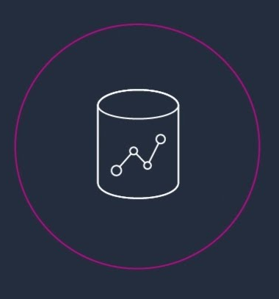

AWS Redshift
Welcome

Slide 2
AWS Redshift – Not just a Data warehousing Solution
Notes:
Redshift uses Massively Parallel Processing (MPP) technology to process massive volumes of data at lightning speeds & costs a fraction of the cost of other data platforms.

Slide 3
Architecture Deep Dive

Slide 4
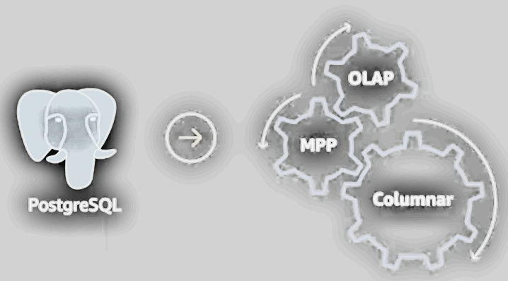
Backend was re-written to be columnar.
Storage engine is not like Postgres.
Based on MPP, thus can scale upto and more than 128 compute nodes i.e. 8.2 PB of storage.
Includes various OLAP, ML, windowing, approximation & geospatial functions.

Slide 5
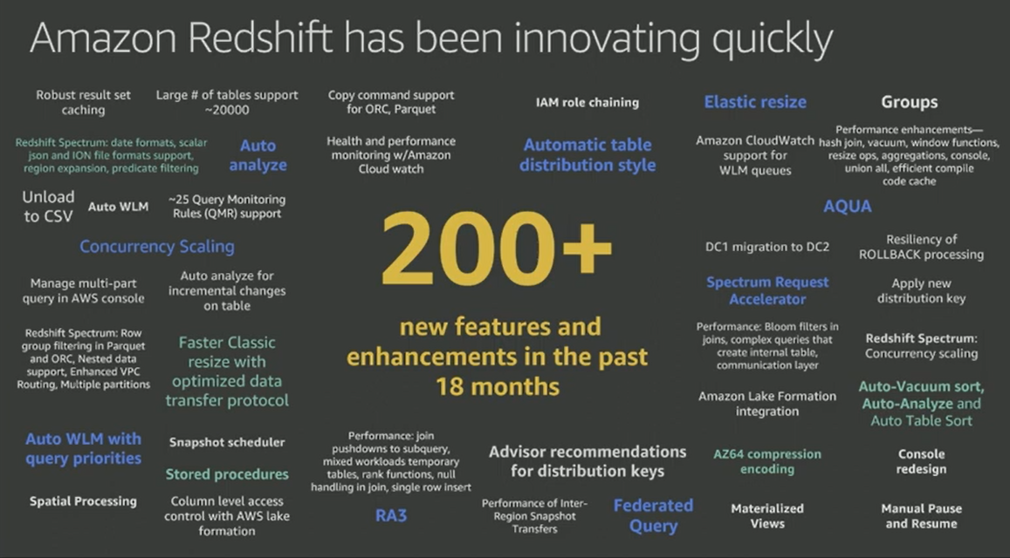
250 + Features and enhancements in past years

Slide 6
SQL Clients
SQL endpoint
JDBC/ODBC drivers supplied by AWS
For others such as dot net, R, Python, Ruby etc. use open source Postgres driver.
Leader Node (query coordinator)
Stores metadata
Coordinates parallel SQL processing & takes care of final steps in Queries.
Compute Nodes (2-128 or more compute nodes)
Local, columnar storage
Executes queries in parallel though following locality reference principle.
Load, Unload, Backup, Restore
Amazon RS Spectrum Nodes ( a layer of compute that exists between compute nodes and S3 which is provisioned dynamically at query time)
Execute queries directly against S3
It allows you to expose the data in S3 into redshift as an external table & then query it or join it with a table in redshift.

Slide 7
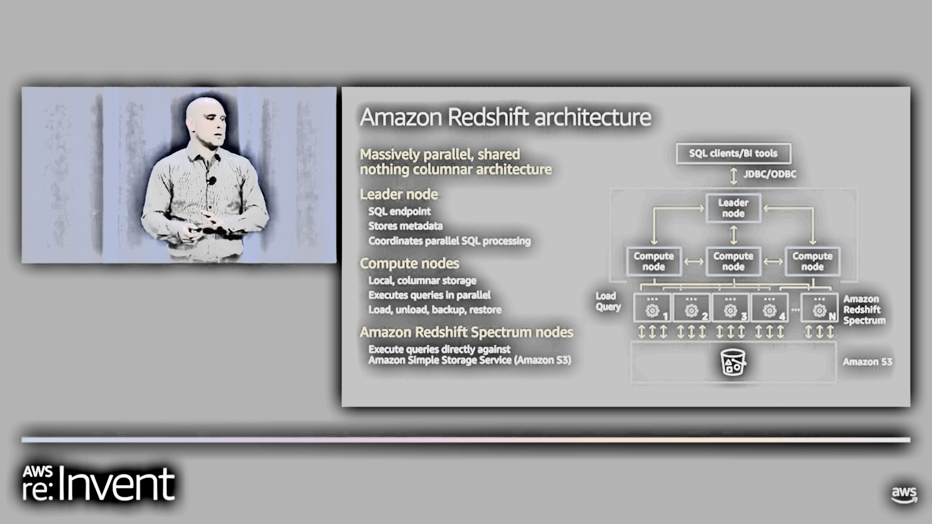
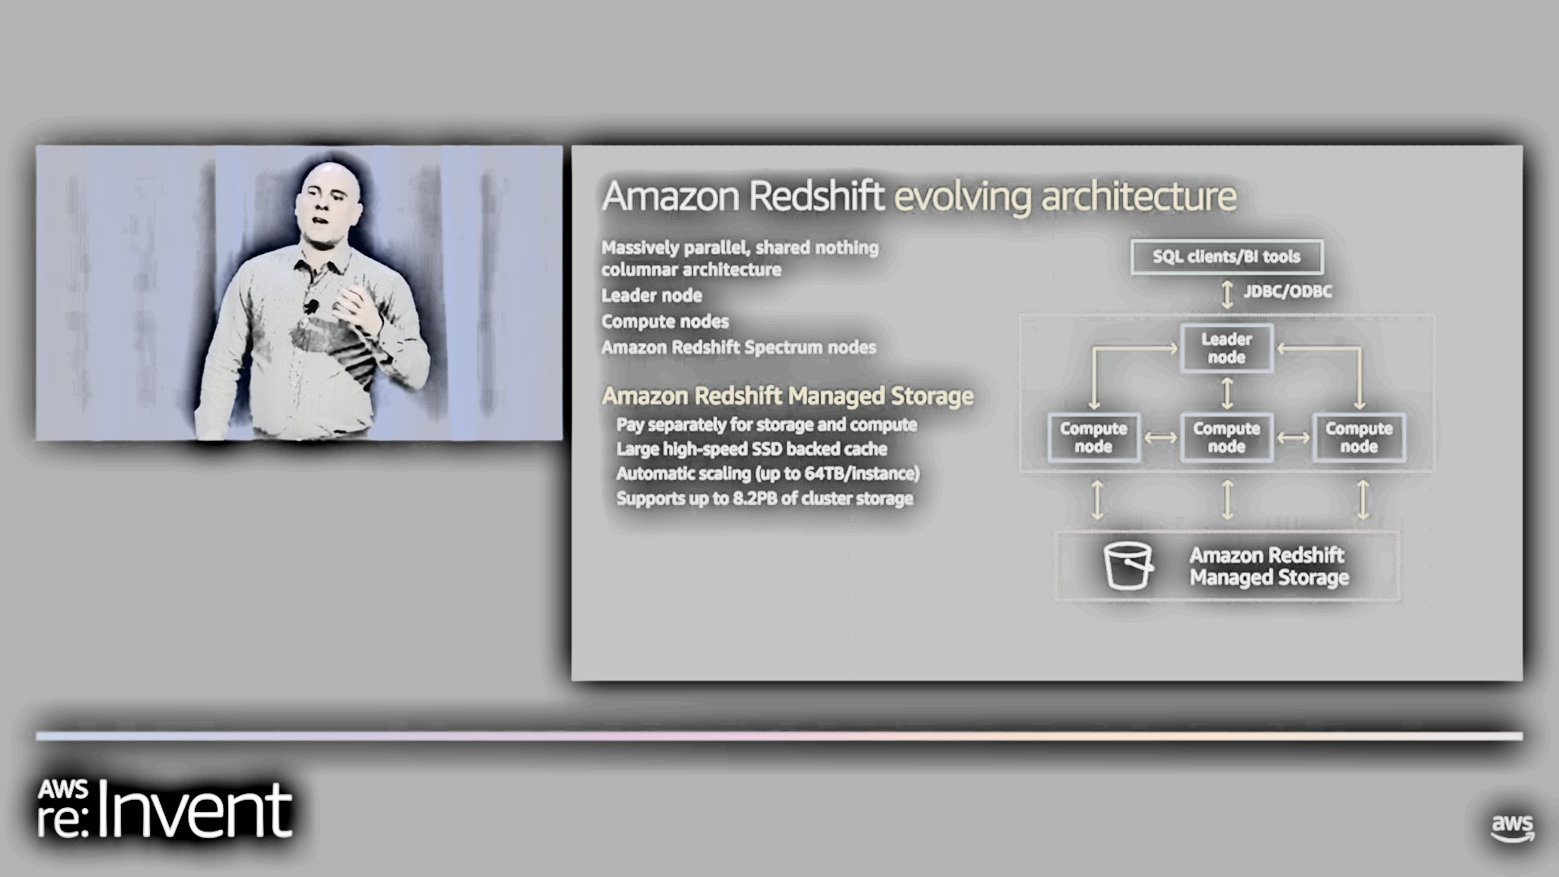
With new feature: Managed storage
Pay separately for storage & compute
Large high-speed SSD backed cache
Automatic scaling upto 64TB/instance
Supports upto 8.2 PB of cluster storage.

Slide 8
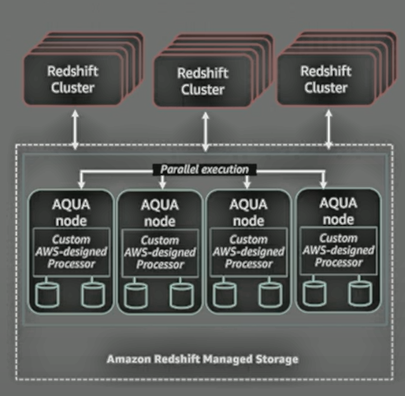
AQUA (Advanced Query Accelerator)
New-distributed & hardware-accelerated processing layer.
Limits the amount of data movement across notes & network.
AQUA makes Redshift 10 times faster than any other cloud data warehouse without any extra cost.
AQUA nodes contain custom AWS-designed analytics processors to make operations (compression, encryption, filtering, aggregation etc.) faster than traditional CPUs.
Available with RA3.

Slide 9
Understanding data storage, design optimizations & considerations

Slide 10
Columnar architecture
id | loc | dt
1 | SFO | 2023-11-20
2 | JFK | 2023-11-20
3 | SFO | 2023-07-01
4 | JFK | 2023-08-02
Create table test_data (
id int –customer_id
,loc char(3) –location
,dt date –date );
Select min(dt) from test_data;
Scan blocks of relevant column.
If it was row based storage
Need to read everything
Unnecessary I/O
id
loc
dt
Compression : Allows more data to be stored in cluster
By default, COPY automatically analyzes and compresses data on first load
Analyze compression is a built-in command that finds optimal compression for each column.

Slide 11
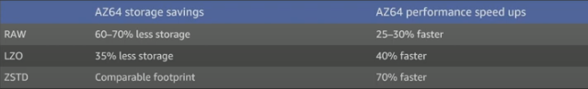
Create table test_data (
id int –customer_id ENCODE Az64
,loc char(3) –location ENCODE BYTEDICT
,dt date –date ENCODE RUNLENGTH);
More efficient compression is due to storing same data type in columnar architecture.
Columns can grow and shrink independently.
Reduces storage requirements and I/O.
New Encoding type: AZ64
Amazon’s proprietary compression encoding algorithm designed to achieve a high compression ratio & improved query processing.

Slide 12
Best Practices in terms of compression:
Apply compression to all tables.
Use AZ64 for INT, SMALLINT, BIGINT, TIMESTAMP, TIMESTAMPTZ, DATE, NUMERIC
Use LZO/ZSTD FOR VARCHAR/CHAR.
Use ANALYZE COMPRESSION command to find optimal compression.
RAW(no compression) for sparse columns & small tables.
Changing column encoding requires a table rebuild.
Verify columns are compressed:
SELECT “column", type, encoding FROM PG_TABLE_DEF WHERE tablename = ‘test_data’;

Slide 13
Blocks
Column data is persisted to 1 MB immutable blocks.
Blocks are individually encoded with 1 to 13 encodings.
A full block can contain millions of values.
Zonemaps
To Achieve elimination of unnecessary I/O
To determine which blocks will read of disk at query time.
In-memory block metadata
Contains per-block min and max values
All blocks automatically have zone maps
Effectively prunes blocks that cannot contain data for a given query.

Slide 14
Data sorting
Makes queries faster by increasing the effectiveness of Zonemaps & reduces I/O.
Enables range-restricted scans to prune blocks by leveraging zone maps.
Achieved by ‘SORTKEY’ defined on one of the columns as per distribution strategy.
Optimal ‘SORTKEY’ depends on factors such as
Querying patterns
Business requirements
Data profile
Infrastructure
Create table test_data (
id int –customer_id
,loc char(3) –location
,dt date –date
) SORTKEY (dt, loc) ;
add a sortkey to one or more columns to physically sort data on disk.

Slide 15
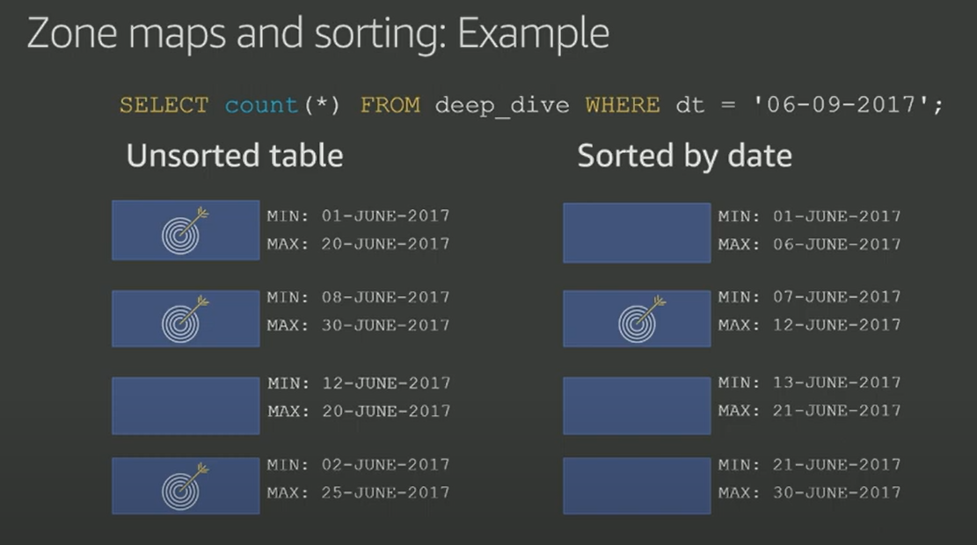
Zone maps with Sorted data = efficient querying
Select count(*) from test_data where dt = ‘06-09-2017’;

Slide 16
Best Practices in terms of sort keys:
Place the sort key on columns that are frequently filtered on placing the lowest cardinality columns first.
On most fact tables , the first sort key column should be a temporal column
Columns added to a sort key after a high-cardinality column are in-effective.
Not effective/beneficial on small tables.
Define 4/less sortkey columns , more can result in increased ingestion overheads.
With an established workload, use the following scripts to help find sort key suggestions
https://github.com/awslabs/amazon-redshift-utils/blob/master/src/AdminScripts/filter_used.sql
https://github.com/awslabs/amazon-redshift-utils/blob/master/src/AdminScripts/predicate_columns.sql

Slide 17
Materialize Columns
How to make queries faster by leveraging Zonemaps on the fact tables.
Frequently filtered and unchanging dimension values should be materialized within fact tables.
Time dimension tables don’t allow range restricted scans on fact tables
Materializing temporal values in fact tables can give significant performance gains.
Example:
Select count(*) from fact_dd join dim_dd using (timeid) where dim_dd.ts >= ‘2018-11-29’;
Select count(*) from fact_dd where fact_dd.timestamp >= ‘2018-11-29’; --faster
Taking data from dimension table , materializing it into fact table benefits from Zonemaps and reduces I/O.

Slide 18
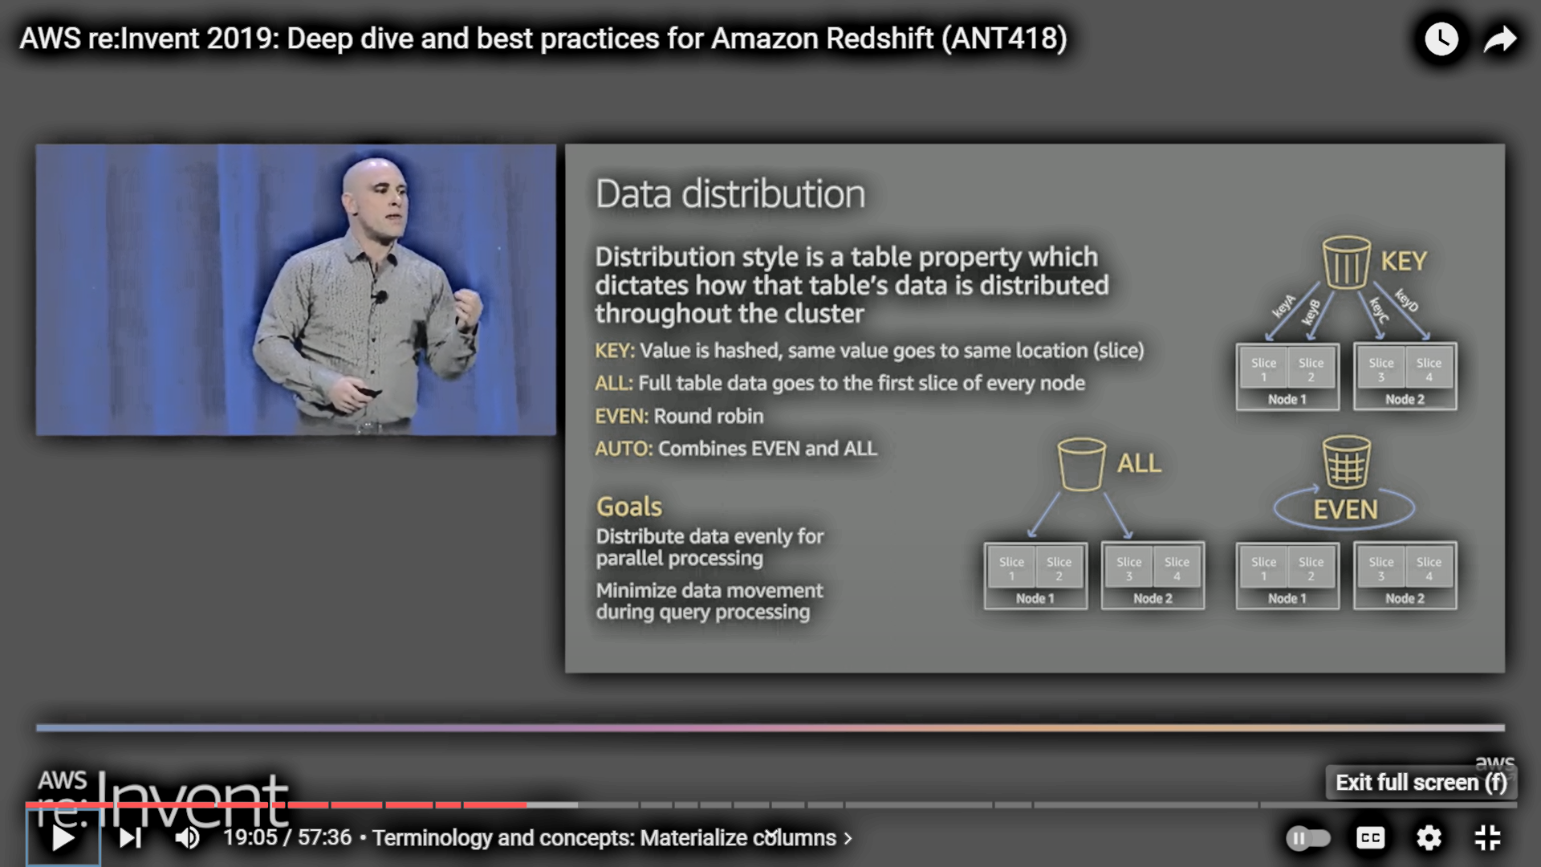
Slices
Slice – In other words ‘virtual compute node’
Unit of data partitioning that facilitates parallel query processing.
Each compute node is initialized with n slices depending on type of nodes.
Data i.e. table rows are distributed to slices and a slice processes its own data.
Data Distribution
Distribution style is a table property which dictates how the table’s data is distributed throughout the cluster.
Goal is to achieve data evenly for parallel processing & reduce data movement during query processing
Key : Value is hashed ,same value goes to same location (slice)
All : Full table data goes to
the first slice of every node.
Even : Round robin
AUTO: Combines EVEN & ALL
Notes:
Key : every row in that table for the column (distribution key column), take the value > hash it > module (slices in the cluster) > entire row lands in that slice.
All : make entire copy of table on every node (used for small tables i.e. < 3 million records).

Slide 19
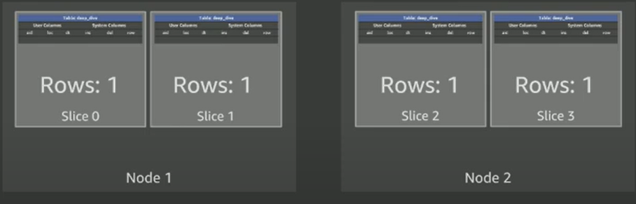
Distribution Style “EVEN”
Create table test_data (
id int –customer_id
,loc char(3) –location
,dt date –date
} DISTSTYLE EVEN;
INSERT INTO TEST_DATA VALUES
(1, ‘SFO’, ‘2023-09-01’),
(2, ‘JFK’, ‘2023-09-14’),
(3, ‘SFO’, ‘2023-04-01’),
(4, ‘SFO’, ‘2023-05-14’);

Slide 20
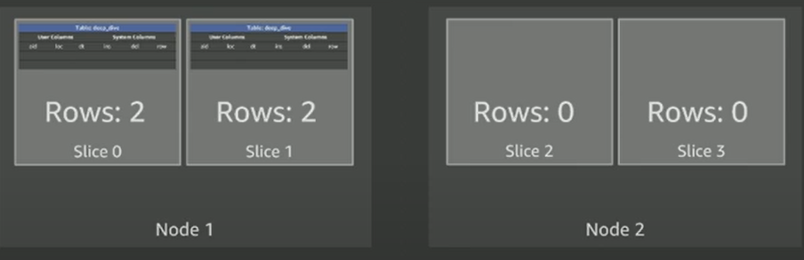
Distribution Style “KEY”
Create table test_data (
id int –customer_id
,loc char(3) –location
,dt date –date
} DISTSTYLE KEY DISTKEY (loc);
INSERT INTO TEST_DATA VALUES
(1, ‘SFO’, ‘2023-09-01’),
(2, ‘JFK’, ‘2023-09-14’),
(3, ‘SFO’, ‘2023-04-01’),
(4, ‘SFO’, ‘2023-05-14’);
Poor distribution strategy and this will lead t query execution only on Node1

Slide 21
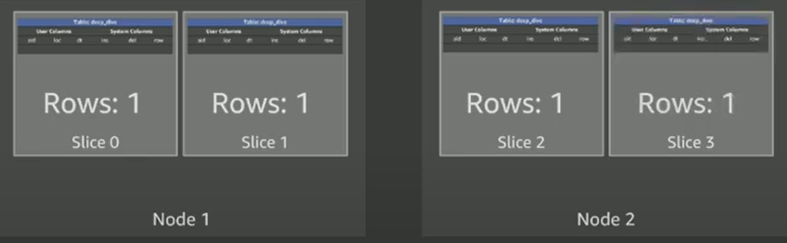
Distribution Style “KEY”
Create table test_data (
id int –customer_id
,loc char(3) –location
,dt date –date
} DISTSTYLE KEY DISTKEY (id);
INSERT INTO TEST_DATA VALUES
(1, ‘SFO’, ‘2023-09-01’),
(2, ‘JFK’, ‘2023-09-14’),
(3, ‘SFO’, ‘2023-04-01’),
(4, ‘SFO’, ‘2023-05-14’);

Slide 22
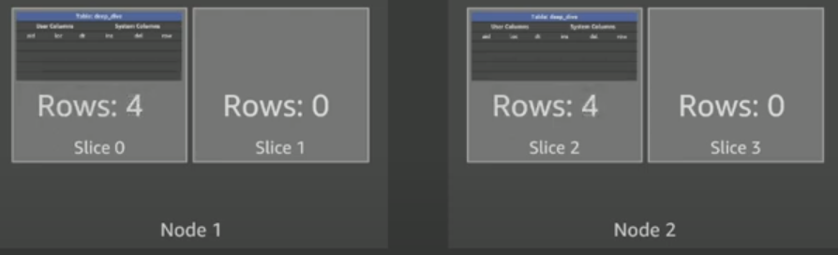
Distribution Style “KEY”
Create table test_data (
id int –customer_id
,loc char(3) –location
,dt date –date
} DISTSTYLE ALL ;
INSERT INTO TEST_DATA VALUES
(1, ‘SFO’, ‘2023-09-01’),
(2, ‘JFK’, ‘2023-09-14’),
(3, ‘SFO’, ‘2023-04-01’),
(4, ‘SFO’, ‘2023-05-14’);
Every row written to both nodes on first slice

Slide 23
Data Distribution
DISTSTYLE KEY
Optimize ‘join’ performance between large tables by distributing columns used in the ON clause
Optimize ‘insert into select’ performance
Optimize ‘group by’ performance
The column that is being distributed should have
a high cardinality and not cause row skew.
DISTSTYLE ALL
Optimize ‘join’ performance with dimension tables
Reduces disc usage on small tables
Small & medium size tables (<3 million rows)
DISTSTYLE EVEN
If neither KEY or ALL apply
When AUTO – combines ALL & EVEN
Select diststyle, skew_rows from
Svv_table_info where “table” = ‘test_table’;
--look at ratio between the slice with the most and least number of rows

Slide 24
Other considerations
Redshift DC/DS instances utilizes locally attached storage devices.
Redshift RA3 nodes utilize Managed storage.
Global commit ensures all permanent tables have blocks written to multiple locations to ensure data redundancy.
Asynchronously backup blocks to Amazon S3 , snapshots are consistent.
Snapshots are generated for every 5GB of changed data / every eight hours.
We can create snapshots manually (on-demand)
Disable backup at table level (add ‘BACKUP NO’ to table definition)
Isolation level is serializable
Two-phase commits (global and local)
Because of commit overheads, limit commits by explicitly creating transactions.

Slide 25
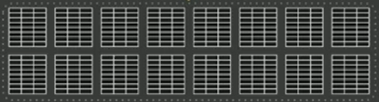
Data Ingestion
RA3.16XL compute node
COPY Statement
Each Slice’s query processors can load one file at a time.
0 | 1 | 2 | 3 | 4 | 5 | 6 | 7 | 8 | 9 | 10 | 11 | 12 | 13 | 14 | 15
If single file was split and stored across cluster nodes, it would be inefficient, instead, in Redshift
Number of input files should be a multiple of the number of slices
Splitting the single file into 16 input files, all slices are working to maximize ingestion performance.
Copy scales linearly as we add more nodes.
Input file
16 Input files
Notes:
Recommendation : use delimited files 1 mb to 1 gb after Gzip compression.

Slide 26
Copy Statement : Considerations
Use delimited files
Pick a simple delimiter such as ‘|’
Pick a simple null character (\N)
Use double quotes & an escape character (‘\’) for varchar
UTF-8 varchar columns take 4 bytes per char
Split files into a number that is a multiple of the total number of slices
‘select count(slices) from stv_slices;’
File sizes should be 1mb to 1gb after GZIP compression.
With ‘copy’ turn off automatic compression – COMUPDATE OFF
When copying a large number of rows (> 100s of millions) consider using ALTER TABLE APPEND instead of INSERT INTO SELECT.

Slide 27
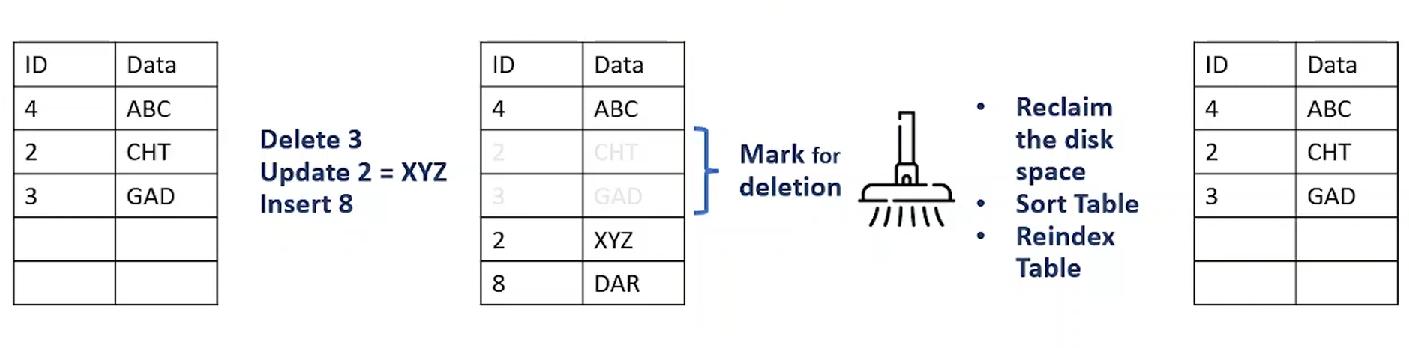
Vacuum in Redshift
Vacuum process reclaims space & sorts the data to improve your query performances.
When we delete or update rows in redshift, data is not removed or replaced immediately, it is marked as deleted until next vacuum operation.
The corresponding XID (i.e. transaction id) is stored in the hidden column ‘DELETE_XID’.

Slide 28
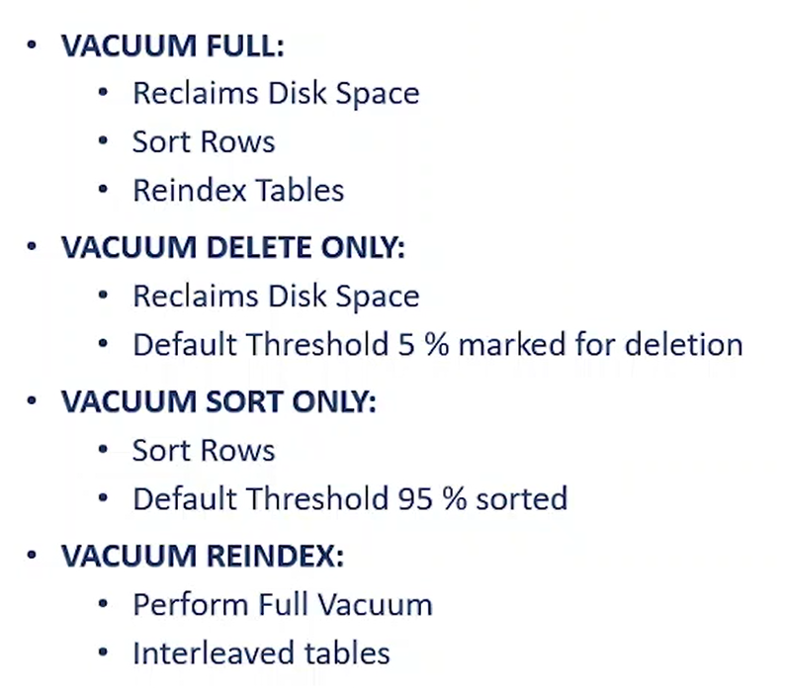
(AUTO) VACUUM
The Vacuum process can run manually or automatically in background
Will remove rows that are marked as deleted
Will globally sort tables
- for tables with a sort key , ingestion operations will locally sort new data and write it to unsorted region.
Should be run only when necessary
For majority of workloads AUTO VACUUM DELETE will reclaim space & AUTO TABLE SORT will sort the needed portions of the table.
Use VACUUM BOOST at off peak times (block deletes), which is as quick as ‘Deep Copy’

Slide 29
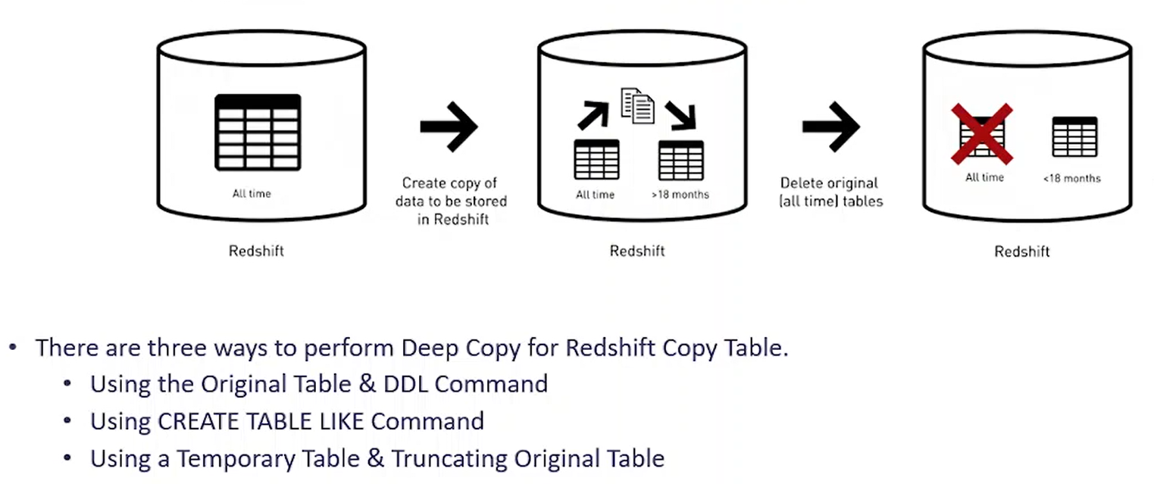
Deep Copy

Slide 30
Understanding AWS Redshift Serverless

Slide 31
Amazon Redshift Serverless
allows you to run and scale analytics without provisioning and managing clusters.
offers flexibility to support a diverse set of workloads of varying complexity, starting at a low price.
measures data warehouse capacity in RPU (Redshift Processing Units) and you pay only for the duration of workloads you run in RPU-hours on a per-second basis.
Earlier the minimum base capacity required to run serverless was : 32 RPU.
New lowered base capacity : 8 RPU
Incrementing & decrementing with 8 RPUs

Slide 32
Under the hood
The new AI-driven scaling and optimization technology enables Amazon Redshift Serverless to automatically and proactively provision and scale data warehouse capacity, delivering fast performance.
The system uses AI techniques to learn customer workload patterns across key dimensions, such as concurrent queries, query complexity, influx of data volume, and ETL patterns.
It then continually adjusts resources throughout the day and applies tailored performance optimizations. These holistic and AI-enhanced techniques provide the best optimization for a given workload.
We can set a desired price-performance target, and it automatically scales to meet them.
More on this later..

Slide 33
Workload Management (WLM)
Allows for resource separation of different query workloads.
Prioritizing important queries.
Throttle down or abort less important queries.
Control concurrent number of executing queries.
Divide cluster memory.
Set query timeouts to abort long running queries.

Slide 34
Understanding WLM Attributes
Queues are assigned a percentage of cluster memory
SQL queries execute in queue based on
User group (groups to which users belong to)
Query group – session level variable
Query slots (for concurrency)
Division of memory within a WLM queue is correlated with number of concurrent running queries
WLM_QUERY_SLOT_COUNT is a session level variable.
Note** increase it for memory intensive operations such as COPY, VACUUM etc.
SQA – Short query acceleration
Automatically detect short running queries and run them within the short query queue if queuing occurs.
Concurrency scaling
When queues are full, queries are routed to transient Redshift clusters.

Slide 35
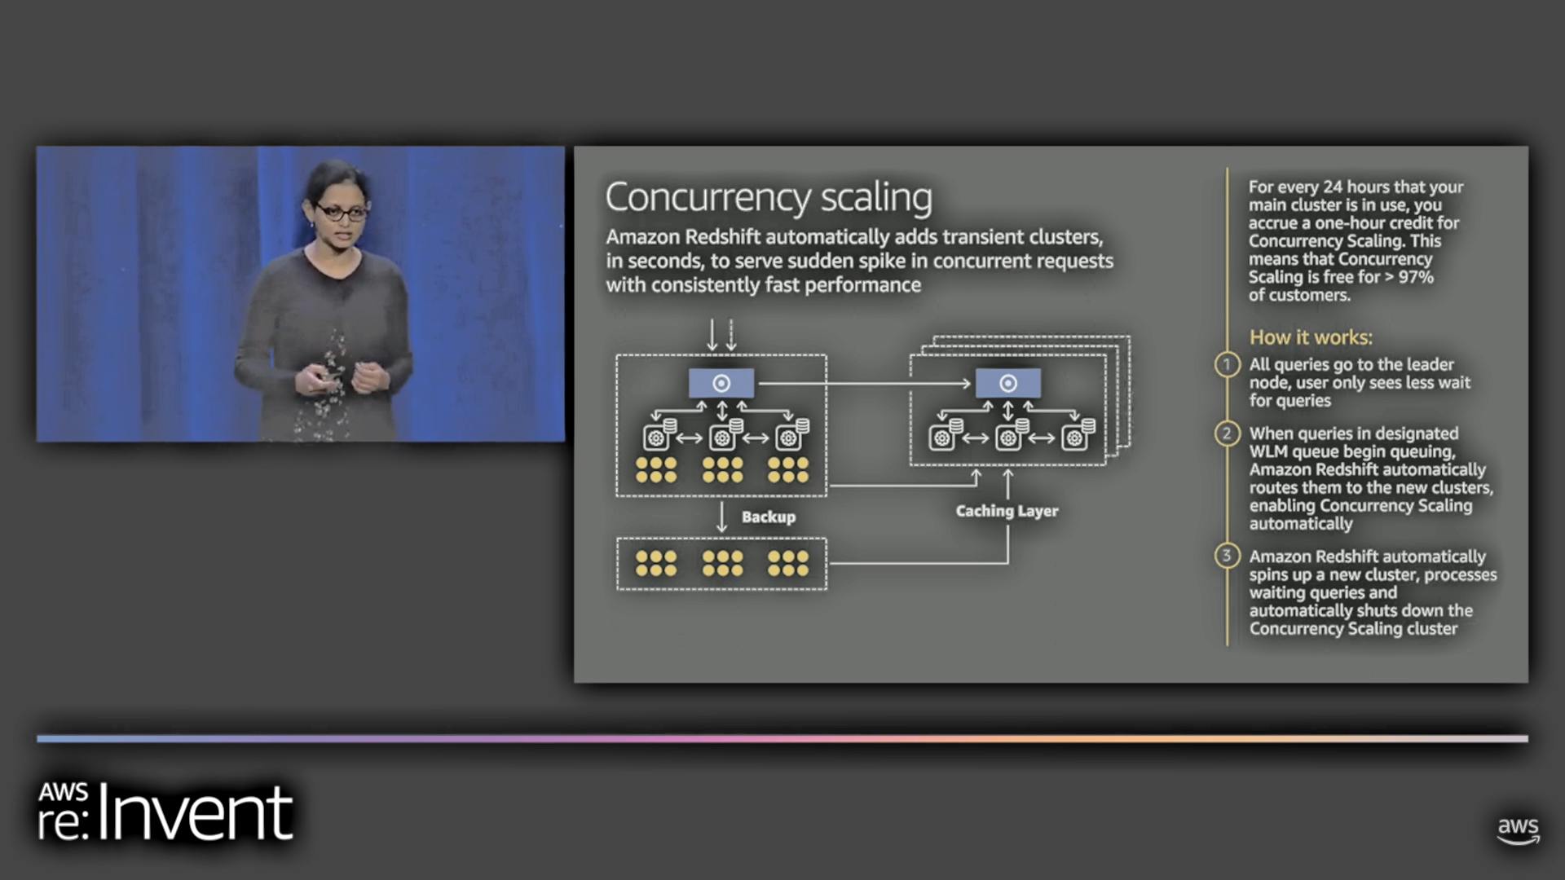
Concurrency scaling : Redshift automatically adds transient clusters, in seconds, to serve sudden spike in concurrent requests with consistently fast performance.
For every 24 hours, our main cluster runs, we accrue a 1-hour credit for concurrency scaling. This means it is free for < 97% of customers.

Slide 36
Concurrency Scaling
All queries hit leader node, user sees less wait for queries.
When queries in WLM queue start queuing up, Redshift routes them to new cluster, enabling Concurrency scaling automatically. Internally redshift takes an incremental automatic snapshot and pushes it to S3.
Redshift spins up a new transient cluster, processes waiting queries and automatically shuts down the concurrency scaling/transient cluster.
As more queries are submitted, it can spin more of these transient clusters.

Slide 37
Monitoring

Slide 38
Query Monitoring
CloudWatch for Monitoring
--for logs in S3
--for log events in CloudWatch

Slide 39
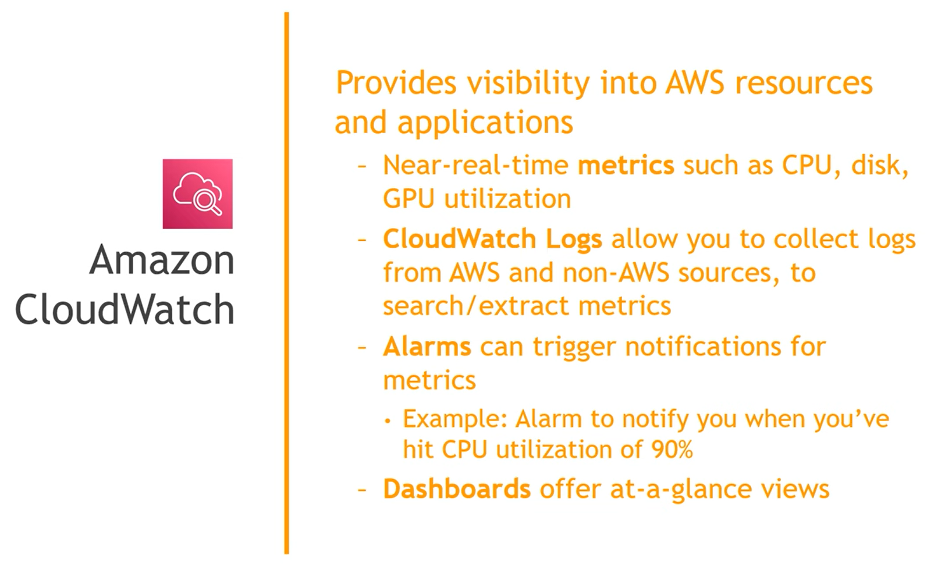

Slide 40
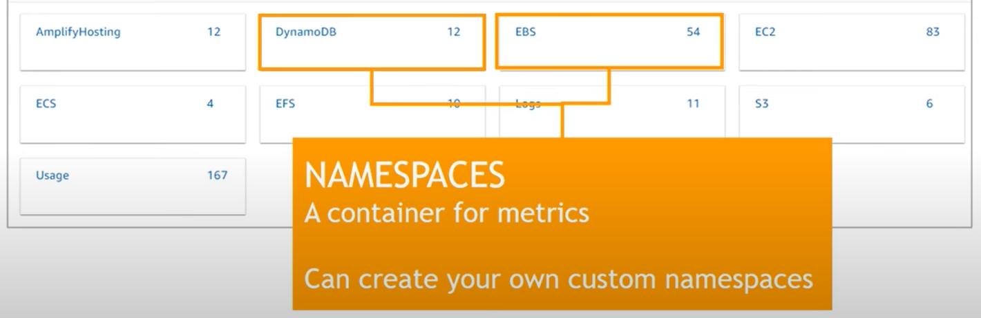
CloudWatch Metrics & Namespaces
Metric : A time-ordered set of data points published to CloudWatch. (region specific)

Slide 41
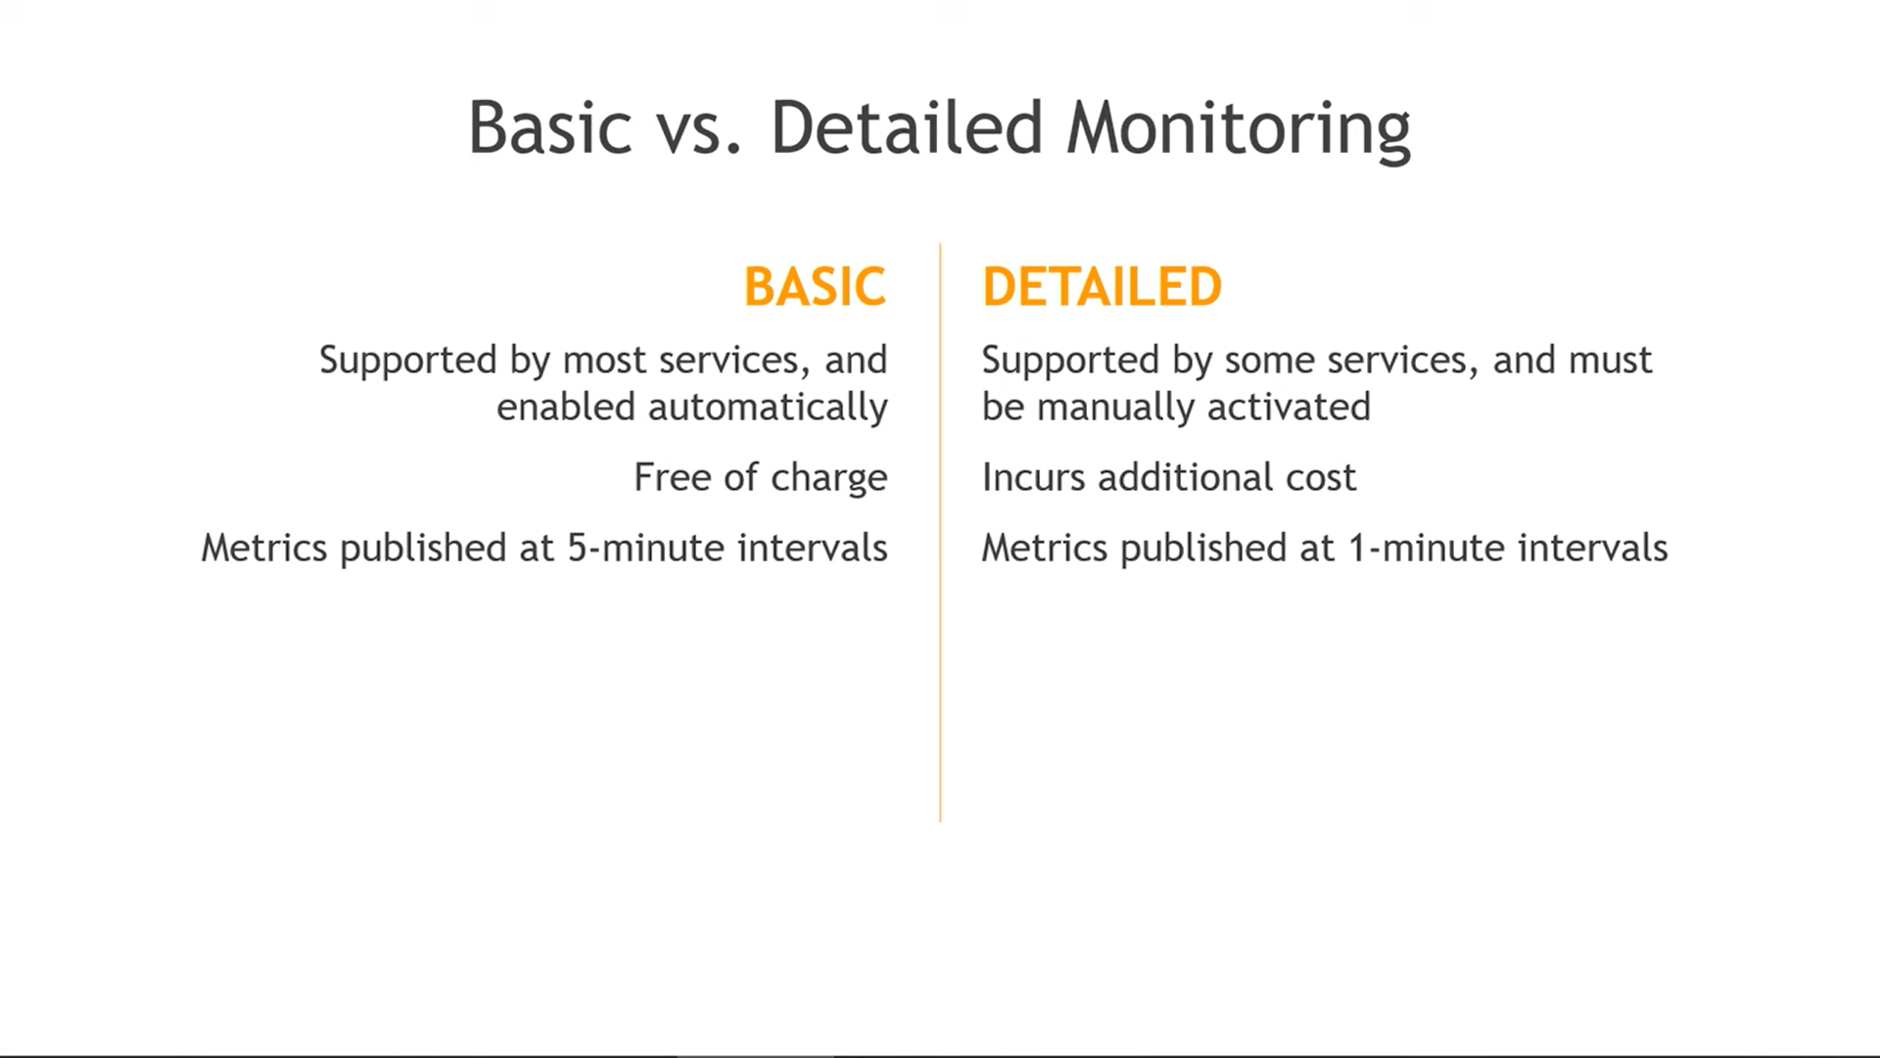
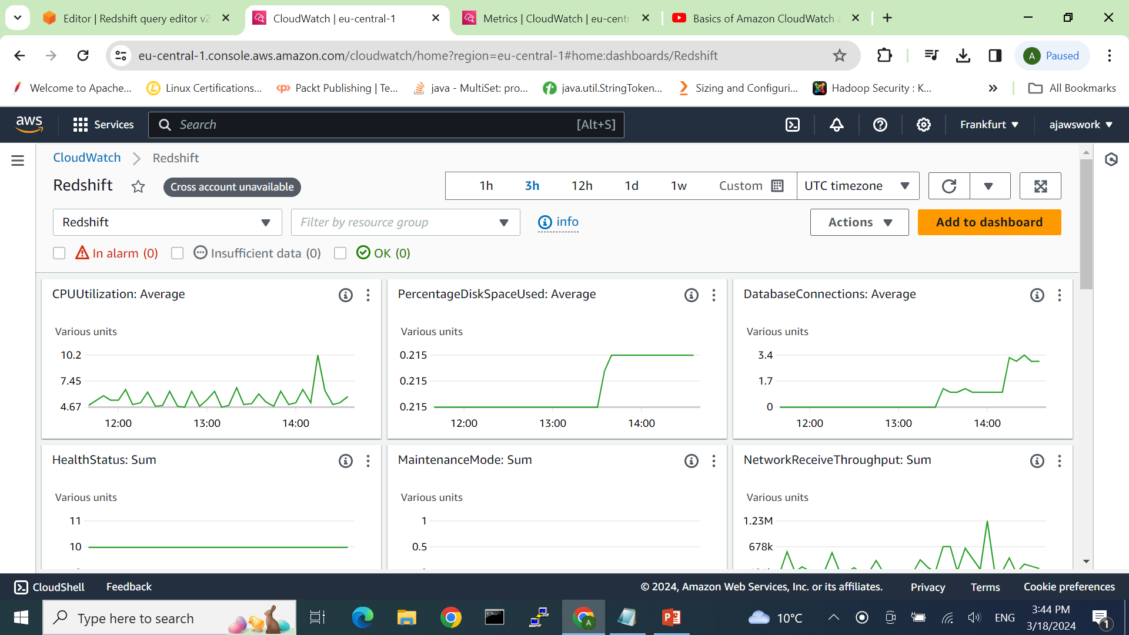
From CloudWatch > All Metrics > (ns) redshift > view automatic dashboard

Slide 42
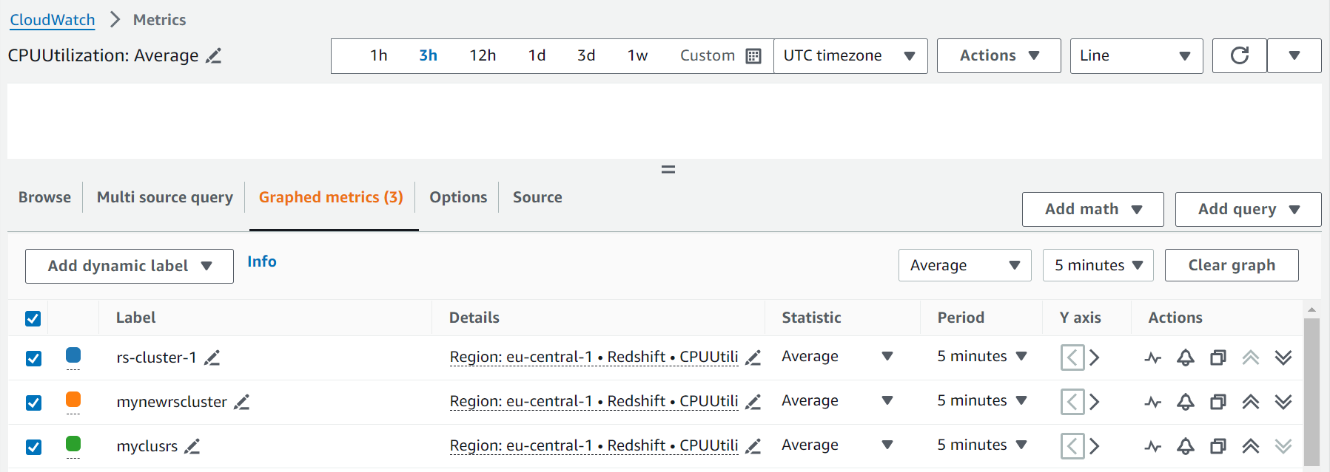
For any widget (option) , we can look in metrics / logs
CPUUtilization Average > looking in metrics

Slide 43
Working with WLM
-- Working with custom parameter group

Slide 44
System Tables
Redshift contains system tables and views that have information about system functioning.
SVV_* views | contain information about database objects with references to transient STV tables.
SYS_* views | used to monitor query and workload usage for provisioned clusters and serverless workgroups.
STL_* views | generated from logs that have been persisted to disk to provide a history of the system.
STV_ * tables | virtual system tables that contain snapshots of the current system data. They are based on transient in-memory data and are not persisted to disk-based logs or regular tables.
SVCS_* views | provide details about queries on both the main and concurrency scaling clusters.
SVL_* views | provide details about queries on main clusters
Notes:
System tables are not included in automated or manual cluster backups (snapshots). STL system views retain seven days of log history.
There are two classes of visibility for data in system tables and views: visible to users and visible to superusers.

Slide 45
Filtering system-generated queries
The query-related system tables and views, such as SVL_QUERY_SUMMARY, SVL_QLOG, and others, usually contain a large number of automatically generated statements that Amazon Redshift uses to monitor the status of the database.
These system-generated queries are visible to a superuser.
To filter them out when selecting from a system table or system view that uses the userid column, add the condition userid > 1 to the WHERE clause.
select * from svl_query_summary where userid > 1

Slide 46
Refer & Query System Tables

Slide 47
A brief on auto/manual snapshots

Slide 48
References/ Good links
https://aws.amazon.com/blogs/big-data/amazon-redshift-engineerings-advanced-table-design-playbook-preamble-prerequisites-and-prioritization/
https://aws.amazon.com/blogs/big-data/amazon-redshift-engineerings-advanced-table-design-playbook-distribution-styles-and-distribution-keys/
https://repost.aws/knowledge-center/prevent-locks-blocking-queries-redshift
https://github.com/awslabs/amazon-redshift-utils/tree/master/src/AnalyzeVacuumUtility
https://repost.aws/search/knowledge-center?globalSearch=redshift
https://github.com/awslabs/amazon-redshift-utils/blob/master/src/AnalyzeVacuumUtility/README.md
https://repost.aws/knowledge-center/redshift-vacuum-reclaim-disk-space
https://aws.amazon.com/blogs/aws/new-aqua-advanced-query-accelerator-for-amazon-redshift/

